Slide 1
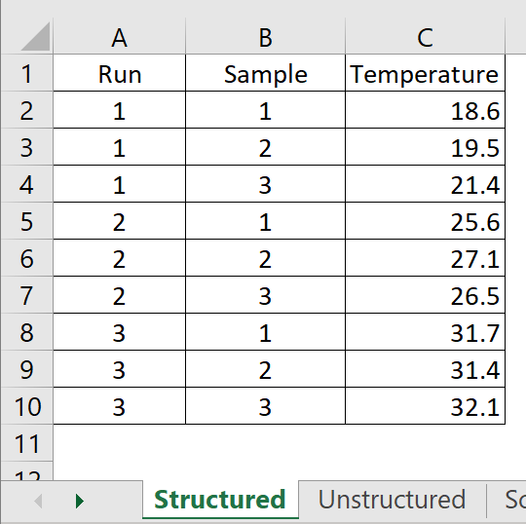
Our Practical “Structured” Definition
Structured Data Examples.xlsx
Unstructured Temperature Example.xlsx
Data are in rows by columns (observations by variables) or can be “effortlessly” transformed to rows by columns
Each measurement type is only in a single column; all values in a measurement column correspond to the measurement type
Rows are all the same “data granularity.”
Table contains “key” columns whose values uniquely differentiate or “index” each row
Each “key” variable is in its own column to enable filtering, sorting and summarization
Tables do not contain blank rows or columns separating data into sub-blocks.
Rows by columns tables are “homed” to top-left corner of their worksheets and are the only data element on the worksheet.
Structured tables can always be sorted into random row order and then re-sorted back to original order using the key columns

Slide 2
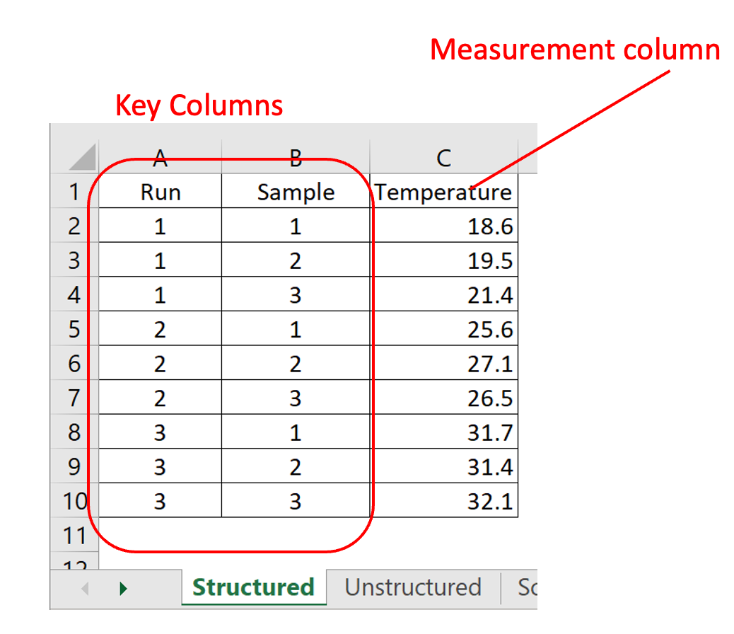
What are “Key” Columns?
Structured Data Examples.xlsx
Unstructured Temperature Example.xlsx
Nametags that uniquely identify rows
Categorical text or integer data type (usually not freely varying)

Slide 3
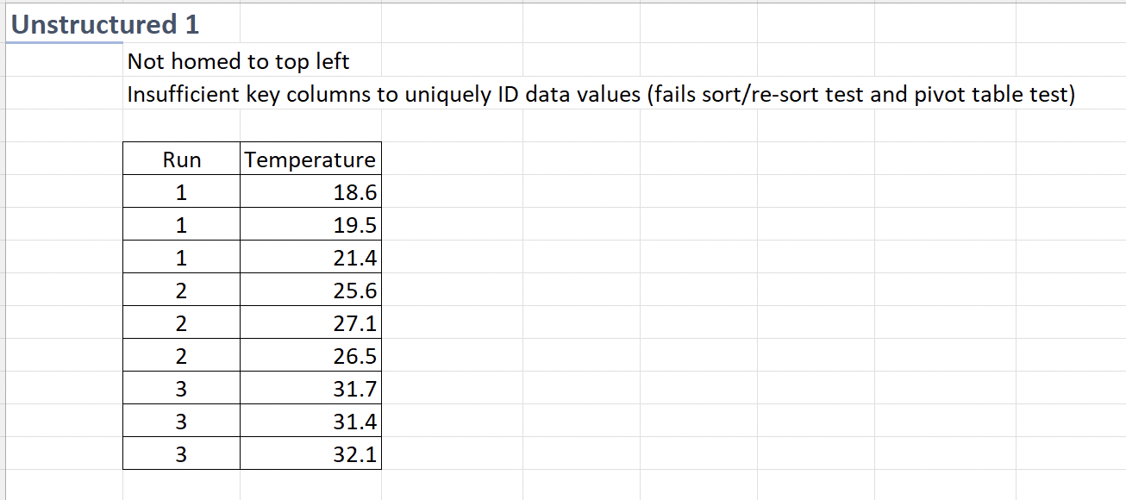
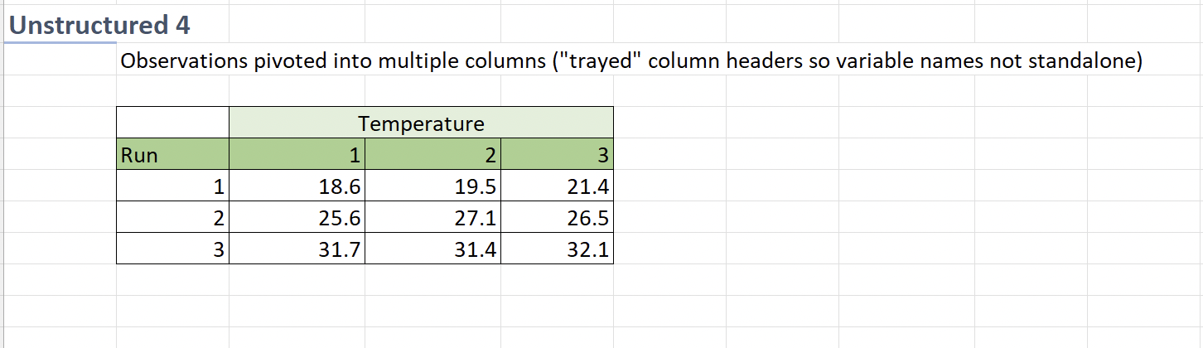
Structured – Some negative examples
Structured Data Examples.xlsx
Unstructured Temperature Example.xlsx
The “Unstructured” tab is a “rogues gallery of common data structures that don’t fit our definition
They are common. See if they are familiar

